Slide 1
Web3 community based crowdfunding platform with block-chain transactions
Submitted in the partial fulfillment for the award of the degree of
BACHELOR OF ENGINEERING
IN
Cloud Computing
Submitted by:
Aadarsh Nagrath | 21BCS5730
Arpit Yadav | 21BCS8916
Mitalee Verma | 21BCS5651
Md. Ishan Anwar | 21BCS9820
Under the Supervision of:
Prof. Bhavna Nayyer
DISCOVER . LEARN . EMPOWER
Department of AIT-CSE

Slide 2
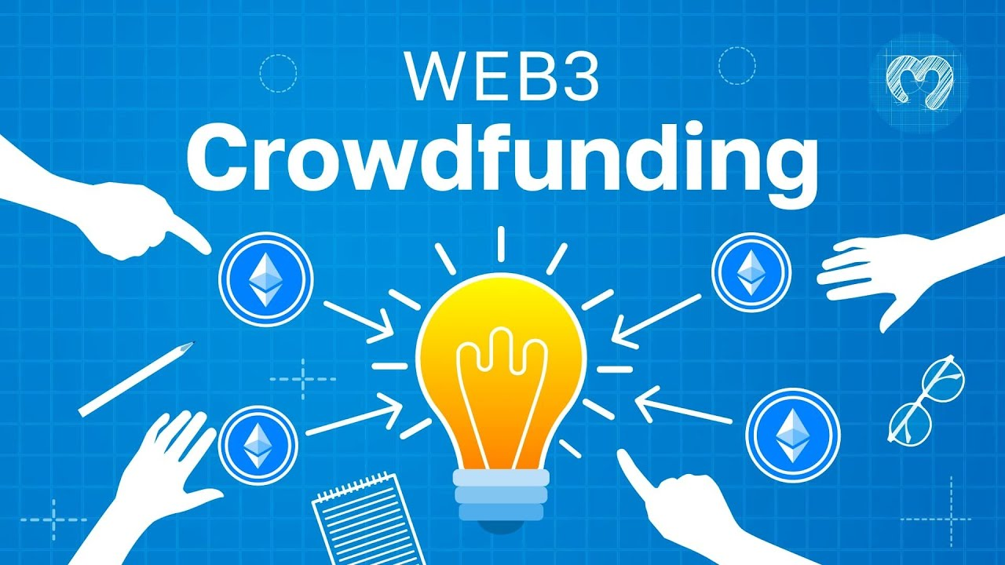
Outline
Introduction to Project
Problem Formulation
Objectives of the work
Design of Project
Methodology
Analysis of Features
Results and Outputs
Conclusion
References

Slide 3
Introduction to Project
In an era where technology shapes our interactions, transactions, and collaborations, the convergence of web3, community dynamics, and blockchain technology is revolutionizing the crowdfunding landscape. Welcome to the forefront of innovation, where a seamless fusion of cutting-edge technologies propels the creation of a dynamic and transparent crowdfunding ecosystem.

Slide 4
Problem Formulation
Current crowdfunding platforms often suffer from centralization, lack of transparency, and limited community involvement.
Project creators may face challenges in accessing funds and showcasing their ideas to a broader audience.
Backers, on the other hand, might be concerned about the authenticity of projects and the allocation of funds.
This calls for a revolutionary approach that utilizes Web3 technology and blockchain to address these issues.

Slide 5
Objectives of the Work
User Authentication and Wallet Integration: Implement a robust user authentication system using Clerk and integrate MetaMask for a secure Ethereum wallet connection.
Community-Centric Interface: Develop an engaging user interface using React and Next.js 13 that combines the aesthetics of the community interaction platform and the crowdfunding platform.
Blockchain Integration and Smart Contracts: Integrate the Ethereum blockchain using the Web3 library to enable secure transactions for campaign contributions.

Slide 6
Campaign Creation and Management: Allow users to create and manage crowdfunding campaigns with funding goals, descriptions, and images.
Community-Based Communication: Enable campaign creators to interact with supporters through threaded discussions/conversations.
Transparent Transactions and Immutability: Highlight the immutability of blockchain data by pairing each transaction with a GIF, showcasing the uniqueness of the platform.
Deployment and Sharing: Deploy the application to the Ethereum network, making it accessible to users for interaction and exploration.

Slide 7
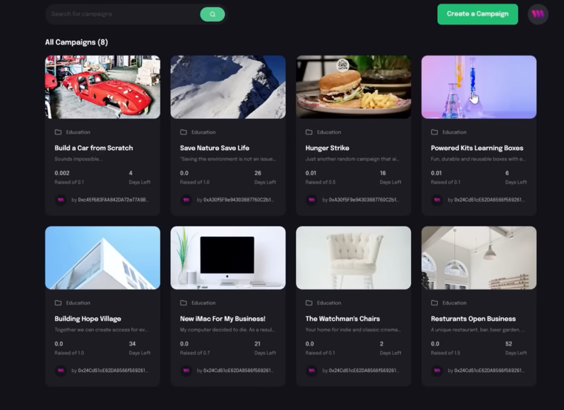
Design Of The Project

Slide 8
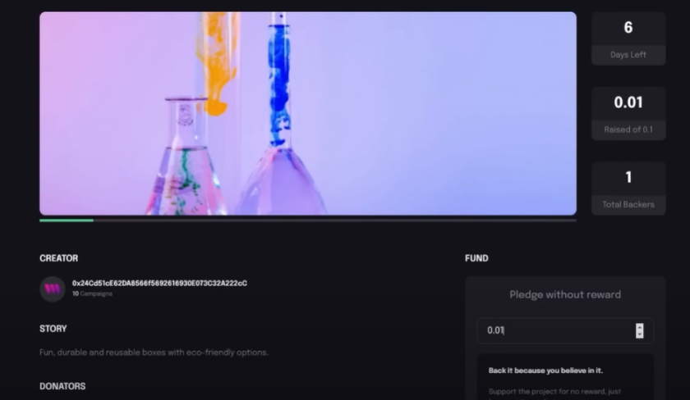
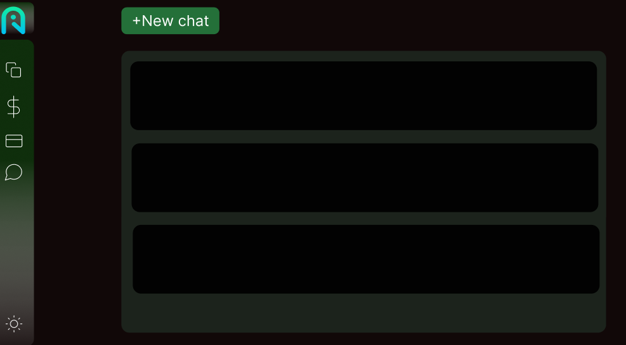

Slide 9
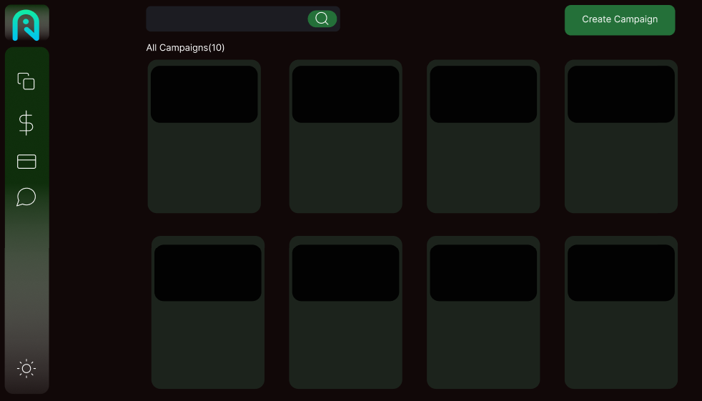
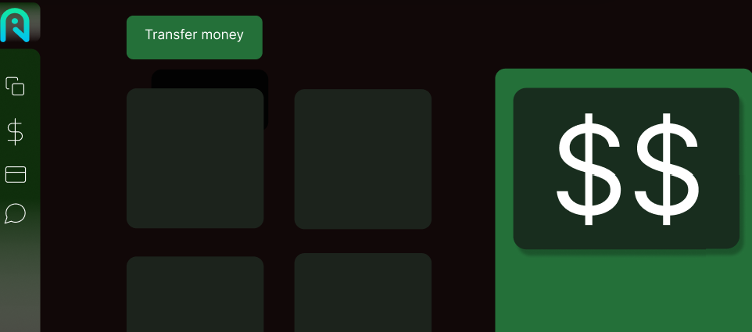

Slide 10
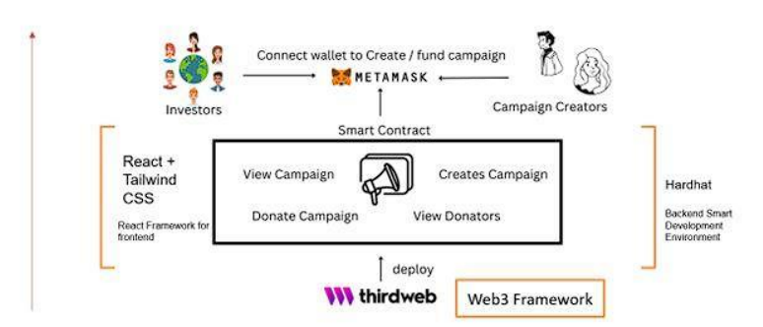

Slide 11
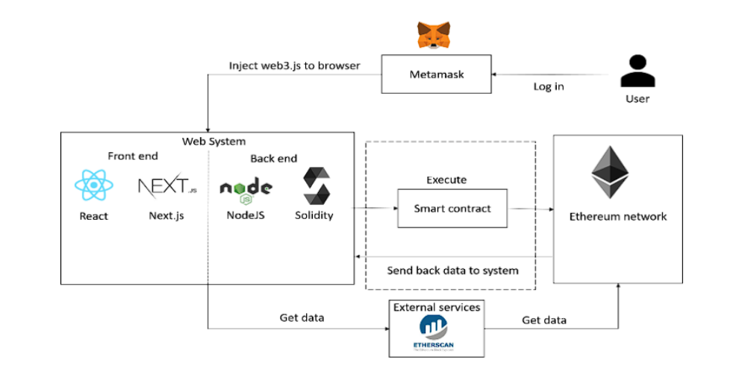
Methodology used

Slide 12
Technology Stack Selection:
ReactJs is chosen as the front-end framework.
NodeJS is selected as the backend technology.
Solidity programming language is used for smart contract development.
Smart Contract Compilation:
Smart contracts written in Solidity are compiled into ABI (Application Binary Interface) code.
The compilation process is performed using the solc npm package.
Web3 Provider Integration:
The ABI interface is parsed to create an instance of a Web3 provider for contract deployment and interaction.
Ethereum Network Connection:
Instead of using a local Ethereum node, the system connects to the Ethereum network via Infura, which serves as a remote node.
User Setup:
Users are required to set up a cryptocurrency wallet called Metamask, which is a browser extension facilitating interaction with decentralized applications (dApps).

Slide 13
Funding the Wallet:
After creating a Metamask account, users need to transfer Ethereum to their wallet to participate in the system.
Web3 Integration:
Metamask injects a Web3 instance into the web browser, allowing users to interact seamlessly with the system.
Campaign Creation:
Users with funded Metamask accounts can create campaigns within the system.
Contribution and Request Creation:
Users can contribute to existing campaigns.
Campaign managers have the ability to create requests to specify how collected funds will be used.
Request Approval Process:
Contributors evaluate and vote on whether the proposed expenses in a request are appropriate.
If the majority of backers approve, Ether is disbursed to the designated vendors.
Ethereum Network Selection:
The system is connected to the Ethereum network, but it uses a testnet, specifically Rinkeby, to simulate transactions.
Transaction Monitoring:
The system's transactions, including successes and failures, can be monitored using the Etherscan API.

Slide 14
Analysis of Features
We are hoping to have a separate crypto token for the Platform, which will serve the purpose of web3 crowd funding platform.
Multiple crypto currencies can be used to fund campaigns.

Slide 15
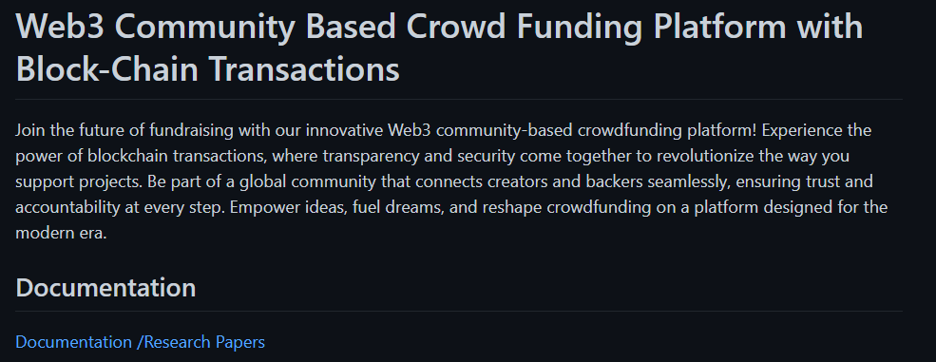
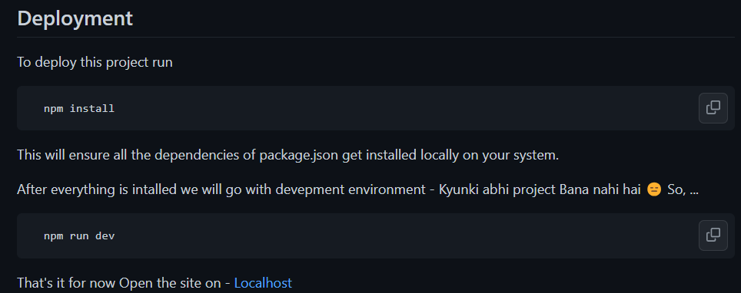
Results and Outputs

Slide 16
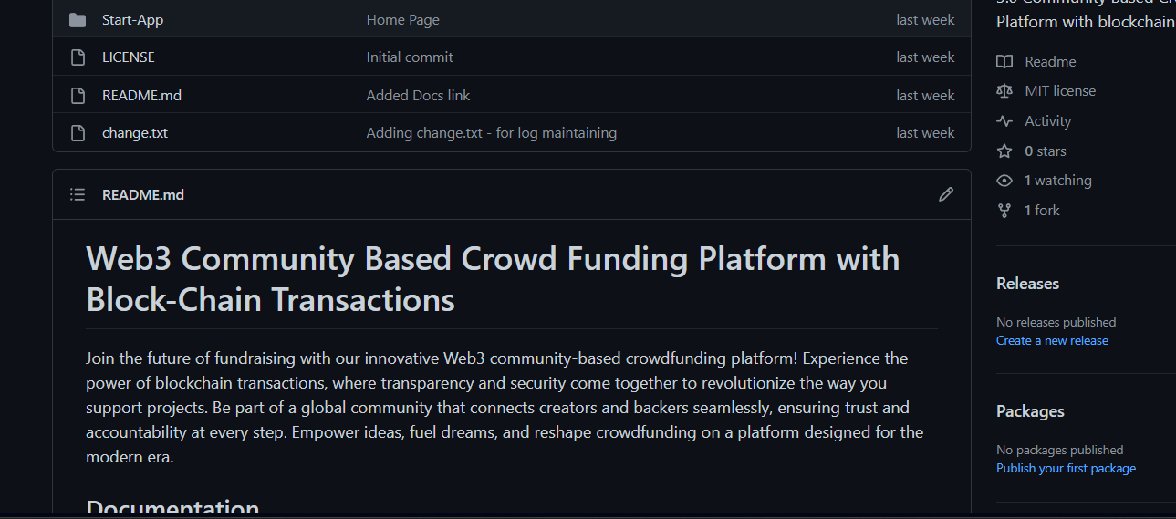


Slide 17
Conclusion
In an era defined by technology's influence, the "Web3 Community-Based Crowdfunding Platform with Blockchain Transactions" stands as a transformative innovation. By harmonizing web3, community dynamics, and blockchain, it forges a dynamic ecosystem that redefines crowdfunding.
As it deploys onto the Ethereum network, it marks a significant step towards a future where empowerment, transparency, and community converge to shape a new crowdfunding paradigm.

